Slide 1

P peline
The Data
Using Weka
© Jennifer Mankoff
The Data Pipeline; HCII; Spring 2014
Slides modified & borrowed from Carolyn Rosé
Want to go deeper? http://see.stanford.edu/see/lecturelist.aspx?coll=348ca38a-3a6d-4052-937d-cb017338d7b1

Slide 2
Using Weka
Weka (Waikato Environment for Knowledge Analysis) is a collection of open source, cross-platform, Java-based ML programs and tools for accessing them that let you fairly quickly and easily make use of a wide range of classification and other techniques
Originally produced by a team at the University of Waikato (New Zealand) and documented in a book:
Ian H. Witten and Eibe Frank (2005) "Data Mining: Practical machine learning tools and techniques", 2nd Edition, Morgan Kaufmann, San Francisco, 2005.

Slide 3
Download, Documentation, etc.
Home page
http://www.cs.waikato.ac.nz/ml/weka/
Download
http://www.cs.waikato.ac.nz/ml/weka/index_downloading.html
Documentation
Manual comes with the download
Requires Java VM (1.5 or later) (which you can get with the Weka download if you want)
Download and install Weka you will need it for Assignment #5

Slide 4
Data for Weka
Assumes data is a collection of (training) instance vectors
Features plus a label
Uses the term “attribute” to refer to an individual data value (either feature or label)

Slide 5
Data for Weka
Assumes data is a collection of (training) instance vectors
Features plus a label
Uses the term “attribute” to refer to an individual data value (either feature or label)
Primary data file format: ARFF (Attribute-Relation File Format)

Slide 6
Sample ARFF File
% Iris Plants Database (from R.A. Fischer and Michael Marshall)
%
@RELATION iris
@ATTRIBUTE sepallength NUMERIC
@ATTRIBUTE sepalwidth NUMERIC
@ATTRIBUTE petallength NUMERIC
@ATTRIBUTE petalwidth NUMERIC
@ATTRIBUTE class {Iris-setosa,Iris-versicolor,Iris-virginica}
@DATA
5.1,3.5,1.4,0.2,Iris-setosa
4.9,3.0,1.4,0.2,Iris-setosa
4.7,3.2,1.3,0.2,Iris-setosa
4.6,?,1.5,0.2,Iris-setosa
…

Slide 7
Sample ARFF File
% Iris Plants Database (from R.A. Fischer and Michael Marshall)
%
@RELATION iris
@ATTRIBUTE sepallength NUMERIC
@ATTRIBUTE sepalwidth NUMERIC
@ATTRIBUTE petallength NUMERIC
@ATTRIBUTE petalwidth NUMERIC
@ATTRIBUTE class {Iris-setosa,Iris-versicolor,Iris-virginica}
@DATA
5.1,3.5,1.4,0.2,Iris-setosa
4.9,3.0,1.4,0.2,Iris-setosa
4.7,3.2,1.3,0.2,Iris-setosa
4.6,?,1.5,0.2,Iris-setosa
…
A comment

Slide 8
Sample ARFF File
% Iris Plants Database (from R.A. Fischer and Michael Marshall)
%
@RELATION iris
@ATTRIBUTE sepallength NUMERIC
@ATTRIBUTE sepalwidth NUMERIC
@ATTRIBUTE petallength NUMERIC
@ATTRIBUTE petalwidth NUMERIC
@ATTRIBUTE class {Iris-setosa,Iris-versicolor,Iris-virginica}
@DATA
5.1,3.5,1.4,0.2,Iris-setosa
4.9,3.0,1.4,0.2,Iris-setosa
4.7,3.2,1.3,0.2,Iris-setosa
4.6,?,1.5,0.2,Iris-setosa
…
Name for this collection of data

Slide 9
Sample ARFF File
% Iris Plants Database (from R.A. Fischer and Michael Marshall)
%
@RELATION iris
@ATTRIBUTE sepallength NUMERIC
@ATTRIBUTE sepalwidth NUMERIC
@ATTRIBUTE petallength NUMERIC
@ATTRIBUTE petalwidth NUMERIC
@ATTRIBUTE class {Iris-setosa,Iris-versicolor,Iris-virginica}
@DATA
5.1,3.5,1.4,0.2,Iris-setosa
4.9,3.0,1.4,0.2,Iris-setosa
4.7,3.2,1.3,0.2,Iris-setosa
4.6,?,1.5,0.2,Iris-setosa
…
Name and type of each attribute

Slide 10
Sample ARFF File
% Iris Plants Database (from R.A. Fischer and Michael Marshall)
%
@RELATION iris
@ATTRIBUTE sepallength NUMERIC
@ATTRIBUTE sepalwidth NUMERIC
@ATTRIBUTE petallength NUMERIC
@ATTRIBUTE petalwidth NUMERIC
@ATTRIBUTE class {Iris-setosa,Iris-versicolor,Iris-virginica}
@DATA
5.1,3.5,1.4,0.2,Iris-setosa
4.9,3.0,1.4,0.2,Iris-setosa
4.7,3.2,1.3,0.2,Iris-setosa
4.6,?,1.5,0.2,Iris-setosa
…
Nothing special about this name But, Weka assumes the last attribute is the class unless you tell it otherwise (which you should!)

Slide 11
Data types
Numeric (can also declare to be Integer or Real)
String (Single quotes, backslash to escape a quote)
Date
Can specify exact parse/print format (see SimpleDataFormat)
Default: yyyy-MM-dd’T’HH:mm:ss
Nominal
Declared as list of values: {v1, v2, …, vn}
Case sensitive names in the actual data
Relational
Nested relation (list of attributes)
Given in actual data inside double quotes: “1,2,’foo’,Bar”

Slide 12
Sample ARFF File
% Iris Plants Database (from R.A. Fischer and Michael Marshall)
%
@RELATION iris
@ATTRIBUTE sepallength NUMERIC
@ATTRIBUTE sepalwidth NUMERIC
@ATTRIBUTE petallength NUMERIC
@ATTRIBUTE petalwidth NUMERIC
@ATTRIBUTE class {Iris-setosa,Iris-versicolor,Iris-virginica}
@DATA
5.1,3.5,1.4,0.2,Iris-setosa
4.9,3.0,1.4,0.2,Iris-setosa
4.7,3.2,1.3,0.2,Iris-setosa
4.6,?,1.5,0.2,Iris-setosa
…
Data is done as comma separated values

Slide 13
Sample ARFF File
% Iris Plants Database (from R.A. Fischer and Michael Marshall)
%
@RELATION iris
@ATTRIBUTE sepallength NUMERIC
@ATTRIBUTE sepalwidth NUMERIC
@ATTRIBUTE petallength NUMERIC
@ATTRIBUTE petalwidth NUMERIC
@ATTRIBUTE class {Iris-setosa,Iris-versicolor,Iris-virginica}
@DATA
5.1,3.5,1.4,0.2,Iris-setosa
4.9,3.0,1.4,0.2,Iris-setosa
4.7,3.2,1.3,0.2,Iris-setosa
4.6,?,1.5,0.2,Iris-setosa
…
Missing data denoted with a question mark

Slide 14
Data for Weka
Weka will also read simple comma-separated-value (CSV) files
Easy to create in Excel
First line is attribute names, rest are data
Weka will infer data types based on what it sees
And binary serialized data (from its own internal data structures)
Much faster to load
Note: Weka tends to want to use attribute numbers instead of names in specifications (but not output)
This tends to be messy: will want to remove attributes e.g., based on feature selection, but then the numbers change (Unfortunately, just one of many usability problems)

Slide 15
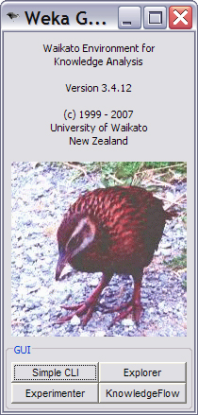
Running Weka
Will want to invoke using “with console” option
Exceptions (and other messages) will show up on the console
Occasionally the underlying Java crashes in ways that the Explorer UI does not catch (more bad UI…)
If it’s taking a lot longer than you expect, check the console…
Starts with this clever interface (press the “Explorer” button)

Slide 16
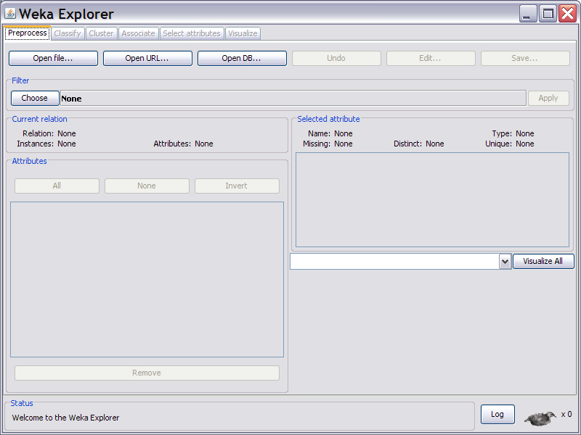
Explorer startup …press “Open file…”

Slide 17
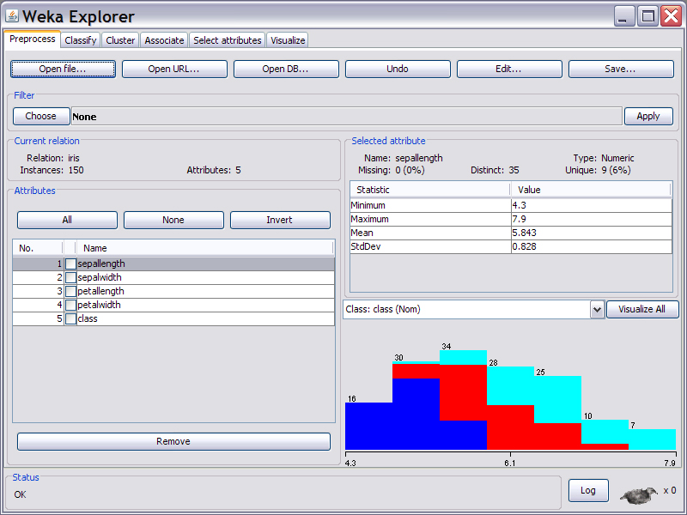

Slide 18
Can manually select features (attrs) here

Slide 19
Can apply programmatic selection here

Slide 20
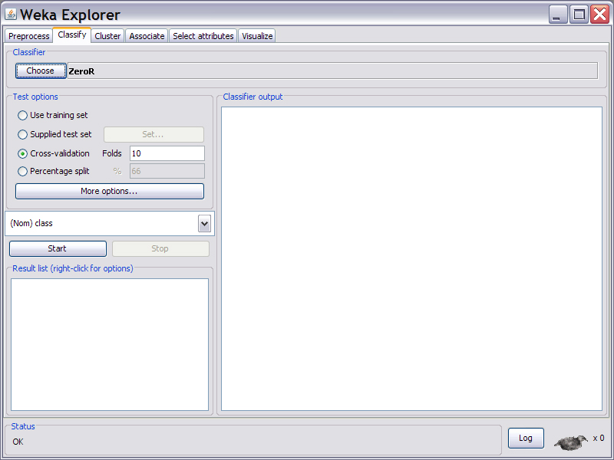
Let’s build a classifier (“Classify” tab)

Slide 21
Let’s build a classifier (“Classify” tab)
Set attribute that represents your class here
Must be done manually, before you try to learn
Common error to forget this!

Slide 22
Let’s build a classifier (“Classify” tab)
How testing is done (10-fold cross is default)

Slide 23
Let’s build a classifier (“Classify” tab)
Pick a type of classifier to learn with by pressing this button and selecting from long hierarchical list
We will choose J48 (C4.5 – like decision trees)

Slide 24
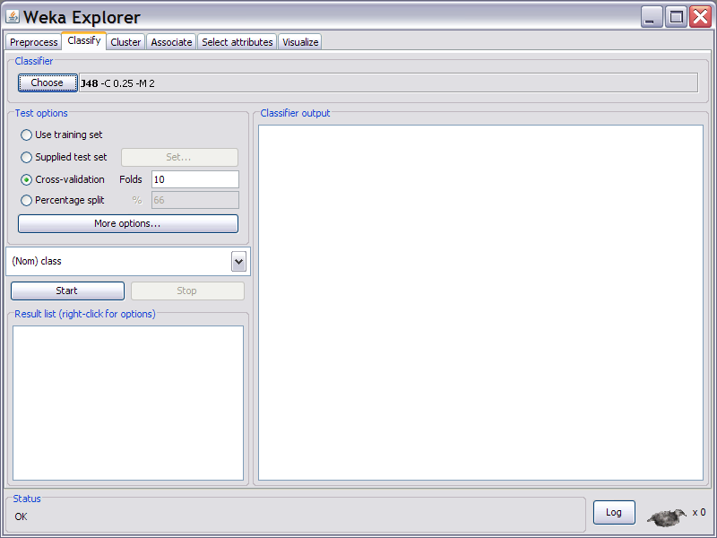
Name of classifier and command line arguments to specify it’s parameters appear here
Not obvious(!), but this text is clickable – click to change the parameters

Slide 25
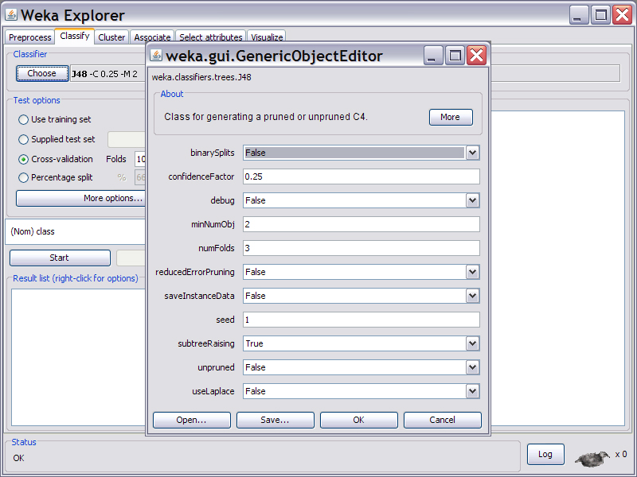
Parameter setting…

Slide 26
Parameter setting…
For data sets that aren’t tiny, change: this to ~ ≤0.1 and this to ~ ≥10
(but your mileage may vary…)

Slide 27
Press this button to build and test the classifier on the data you have loaded

Slide 28
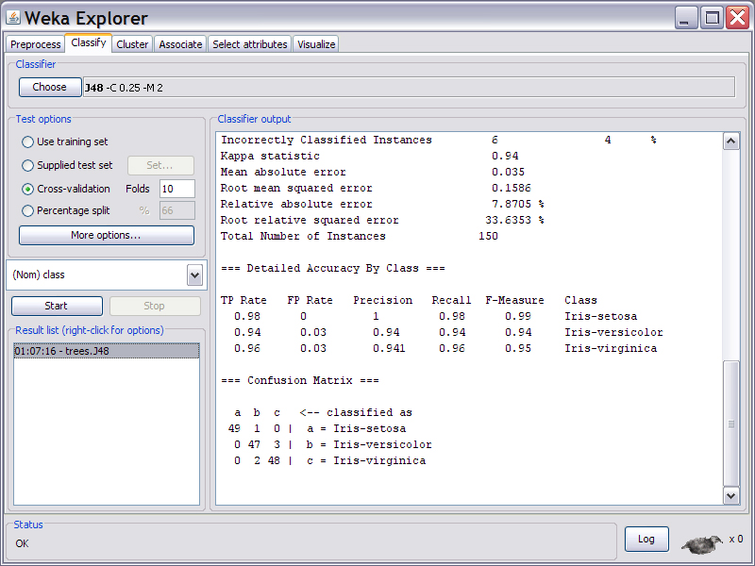
Results as textual output

Slide 29
Right-click here to save output, save resulting classifier, etc.

Slide 30
Output from this run…
=== Run information ===
Scheme: weka.classifiers.trees.J48 -C 0.25 -M 2
Relation: iris
Instances: 150
Attributes: 5
sepallength
sepalwidth
petallength
petalwidth
class
Test mode: 10-fold cross-validation

Slide 31
Output from this run…
=== Classifier model (full training set) ===
J48 pruned tree
------------------
petalwidth <= 0.6: Iris-setosa (50.0)
petalwidth > 0.6
| petalwidth <= 1.7
| | petallength <= 4.9: Iris-versicolor (48.0/1.0)
| | petallength > 4.9
| | | petalwidth <= 1.5: Iris-virginica (3.0)
| | | petalwidth > 1.5: Iris-versicolor (3.0/1.0)
| petalwidth > 1.7: Iris-virginica (46.0/1.0)
Number of Leaves : 5
Size of the tree : 9
Time taken to build model: 0.13 seconds

Slide 32
Output from this run…
=== Stratified cross-validation ===
=== Summary ===
Correctly Classified Instances 144 96 %
Incorrectly Classified Instances 6 4 %
Kappa statistic 0.94
Mean absolute error 0.035
Root mean squared error 0.1586
Relative absolute error 7.8705 %
Root relative squared error 33.6353 %
Total Number of Instances 150

Slide 33
Output from this run…
=== Detailed Accuracy By Class ===
TP Rate FP Rate Precision Recall F-Measure Class
0.98 0 1 0.98 0.99 Iris-setosa
0.94 0.03 0.94 0.94 0.94 Iris-versicolor
0.96 0.03 0.941 0.96 0.95 Iris-virginica
=== Confusion Matrix ===
a b c <-- classified as
49 1 0 | a = Iris-setosa
0 47 3 | b = Iris-versicolor
0 2 48 | c = Iris-virginica

Slide 34
From a naïve Bayes model… (Same accuracy, slightly diff confusion matrix)
Scheme: weka.classifiers.bayes.NaiveBayes
Relation: iris
…
Correctly Classified Instances 144 96 %
…
=== Confusion Matrix ===
a b c <-- classified as
50 0 0 | a = Iris-setosa
0 48 2 | b = Iris-versicolor
0 4 46 | c = Iris-virginica

Slide 35
Hint
Save results from all your runs
Hard to know what you may need (e.g. is trend in false positives going up or down as I change this parameter?)

Slide 36
Hint
Save results from all your runs
Put additional notes with the textual output!
Not everything you need to reconstruct what you did is in the textual output (can’t tell which feature subsets you learned on!)
You will run a lot of these trying various things and soon forget the details

Slide 37
Explorer allows you to try a bunch of things interactively (It can also do wrapper-based feature selection)
And anything you can do there can also be easily invoked from within a Java program for deployment
Java class of learner listed in output
Parameters for learner based on command line options which are also printed for you
weka.classifiers.trees.J48 -C 0.25 -M 2
Data tables for most classifier types can be saved in a file (from explorer) and pulled back in for classifier at runtime

Slide 38
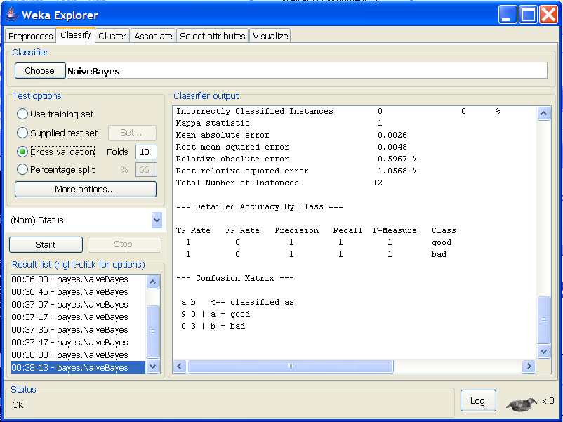
How To Do Cross Validation

Slide 39
How To Do Cross Validation
Notice that
Cross validation
is for testing
only! Not for
building the rule!

Slide 40
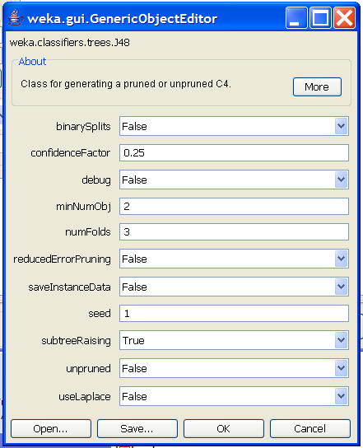
Tuning Decision Trees (J48)
Click on More button for documentation and references to papers
binarySplits: do you allow multi-way distinctions?
confidenceFactor: smaller values lead to more pruning
minNumObj: minimum number of instances per leaf
numFolds: Determines the amount of data for reduced error pruning – one fold used for pruning, the rest for growing the tree
reducedErrorPruning: whether to use reduced error pruning or not
subtreeRaising: whether to use subtree raising during pruning
Unpruned: whether pruning takes place at all
useLaplace: whether to use Laplace smoothing at leaf nodes

Slide 41
First Choice: Binary splits or not
Click on More button for documentation and references to papers
binarySplits: do you allow multi-way distinctions?
confidenceFactor: smaller values lead to more pruning
minNumObj: minimum number of instances per leaf
numFolds: Determines the amount of data for reduced error pruning – one fold used for pruning, the rest for growing the tree
reducedErrorPruning: whether to use reduced error pruning or not
subtreeRaising: whether to use subtree raising during pruning
Unpruned: whether pruning takes place at all
useLaplace: whether to use Laplace smoothing at leaf nodes

Slide 42
Second Choice: Pruning or not
Click on More button for documentation and references to papers
binarySplits: do you allow multi-way distinctions?
confidenceFactor: smaller values lead to more pruning
minNumObj: minimum number of instances per leaf
numFolds: Determines the amount of data for reduced error pruning – one fold used for pruning, the rest for growing the tree
reducedErrorPruning: whether to use reduced error pruning or not
subtreeRaising: whether to use subtree raising during pruning
Unpruned: whether pruning takes place at all
useLaplace: whether to use Laplace smoothing at leaf nodes

Slide 43
Third Choice: If you want to prune, what kind of pruning will you do?
Click on More button for documentation and references to papers
binarySplits: do you allow multi-way distinctions?
confidenceFactor: smaller values lead to more pruning
minNumObj: minimum number of instances per leaf
numFolds: Determines the amount of data for reduced error pruning – one fold used for pruning, the rest for growing the tree
reducedErrorPruning: whether to use reduced error pruning or not
subtreeRaising: whether to use subtree raising during pruning
Unpruned: whether pruning takes place at all
useLaplace: whether to use Laplace smoothing at leaf nodes

Slide 44
Fifth Choice: How to decide where to prune?
Click on More button for documentation and references to papers
binarySplits: do you allow multi-way distinctions?
confidenceFactor: smaller values lead to more pruning
minNumObj: minimum number of instances per leaf
numFolds: Determines the amount of data for reduced error pruning – one fold used for pruning, the rest for growing the tree
reducedErrorPruning: whether to use reduced error pruning or not
subtreeRaising: whether to use subtree raising during pruning
Unpruned: whether pruning takes place at all
useLaplace: whether to use Laplace smoothing at leaf nodes

Slide 45
Sixth Choice: Smoothing or not?
Click on More button for documentation and references to papers
binarySplits: do you allow multi-way distinctions?
confidenceFactor: smaller values lead to more pruning
minNumObj: minimum number of instances per leaf
numFolds: Determines the amount of data for reduced error pruning – one fold used for pruning, the rest for growing the tree
reducedErrorPruning: whether to use reduced error pruning or not
subtreeRaising: whether to use subtree raising during pruning
Unpruned: whether pruning takes place at all
useLaplace: whether to use Laplace smoothing at leaf nodes

Slide 46
Seventh Choice: Stopping Criterion
Click on More button for documentation and references to papers
binarySplits: do you allow multi-way distinctions?
confidenceFactor: smaller values lead to more pruning
minNumObj: minimum number of instances per leaf
numFolds: Determines the amount of data for reduced error pruning – one fold used for pruning, the rest for growing the tree
reducedErrorPruning: whether to use reduced error pruning or not
subtreeRaising: whether to use subtree raising during pruning
Unpruned: whether pruning takes place at all
useLaplace: whether to use Laplace smoothing at leaf nodes
This should be increased
for noisy data sets!

